Slide 1
IST 659 Final Project:
Otto & Friends
Veterinary Hospital
Jianghui Li, Chensheng Ma, Leah Mitchell

Slide 2
Problem Application: Vet Hospital
Key Stakeholders:
Owners & their pets (patients)
Doctors
Key Information:
Patient, Owner, and Doctor Information
Contact information, insurance, type of animal, animals able to treat
Appointments
Who, what, when, where
Bills
How much, payed or not

Slide 3
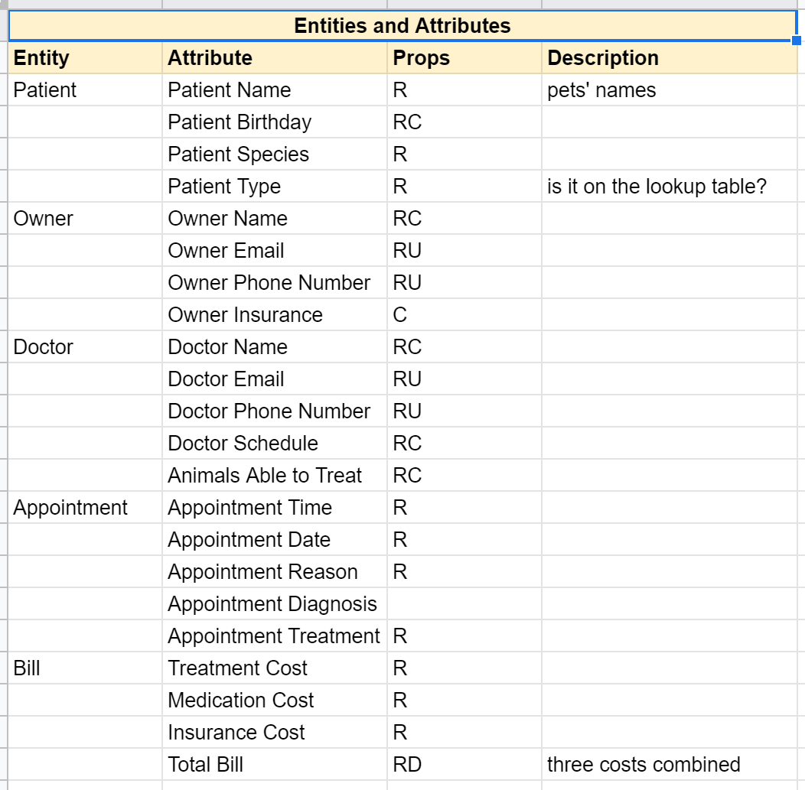
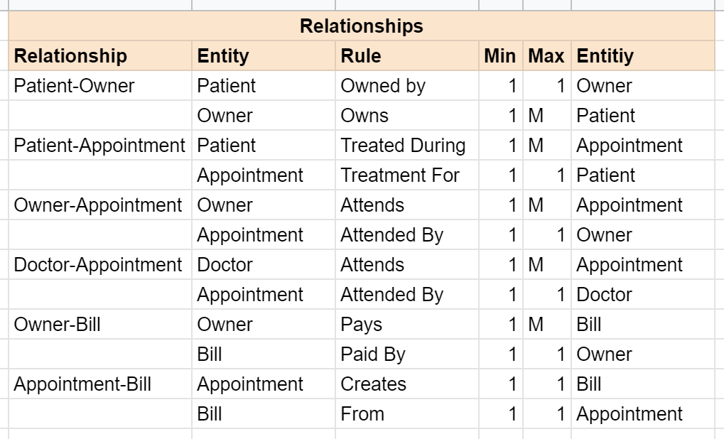
Requirements
Relationships, the needed tables, the info we wanted to store

Slide 4
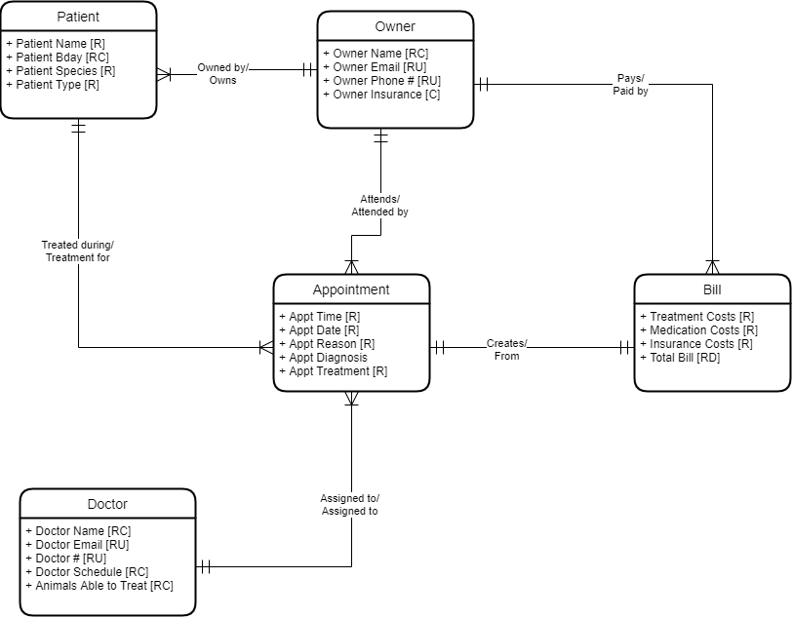
Conceptual
Model

Slide 5
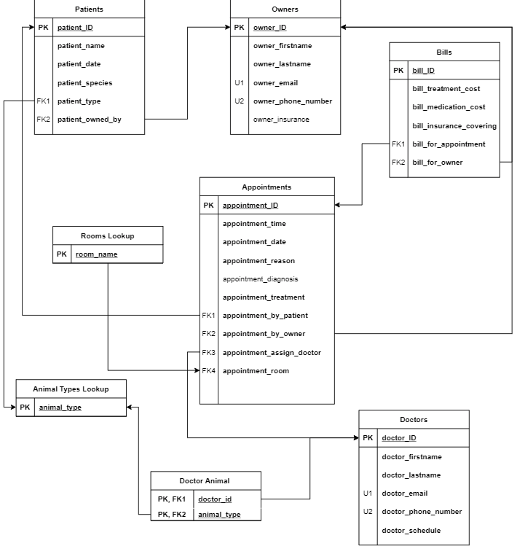
Logical Model

Slide 6
User Stories
As an Owner I should be able to…
View my patients so I can keep track of my animals information
View a list of my appointments so that I can keep track of my schedule
View a list of my bills so I can see what I have had to pay
Create a new appointment so that my pet can be treated
As an Doctor I should be able to…
View patients so I can keep track of a patient's information
View a list of my appointments so I can see my schedule
Enter a new appointment into my schedule so I can treat a patient

Slide 7
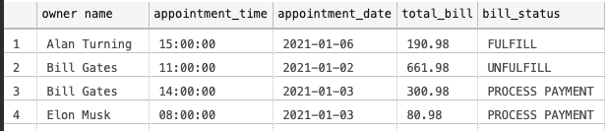
Views
Make sure who is the owner and Check status.
create view view_total_bill as
select j.owner_firstname + ' ' + j.owner_lastname as 'owner name',
k.appointment_time, k.appointment_date,--when we did the appointment and assign bills
SUM(i.bill_treatment_cost + i.bill_medication_cost + i.bill_insurance_covering) as total_bill,
i.bill_status
from bills i
join owners j on j.owner_id = i.bill_for_owner
join appointments k on k.appointment_id = i.bill_for_appointment
group by j.owner_firstname, j.owner_lastname, k.appointment_time, k.appointment_date,i.bill_status
go

Slide 8
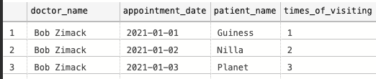
Views
2. Understand which doctor take care of patients and times of taking care.
create view view_appointment_order__by as
select j.owner_firstname + ' ' + j.owner_lastname as 'owner name',
i.patient_name, k.appointment_date, i.patient_type,
rank () over (
partition by j.owner_firstname order by k.appointment_date
) as times_of_appointment
from patients i
left join owners j on j.owner_id = i.patient_owned_by
join appointments k on k.appointment_by_patient = i.patient_id
group by j.owner_firstname, j.owner_lastname, i.patient_name,k.appointment_date,i.patient_type
go

Slide 9
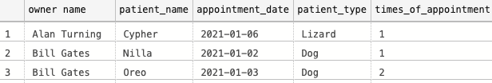
Views
3. Figure out the details about appointments.
create view view_appointment_order__by as
select j.owner_firstname + ' ' + j.owner_lastname as 'owner name',
i.patient_name, k.appointment_date, i.patient_type,
rank () over (
partition by j.owner_firstname order by k.appointment_date
) as times_of_appointment
from patients i
left join owners j on j.owner_id = i.patient_owned_by
join appointments k on k.appointment_by_patient = i.patient_id
group by j.owner_firstname, j.owner_lastname, i.patient_name,k.appointment_date,i.patient_type
go

Slide 10
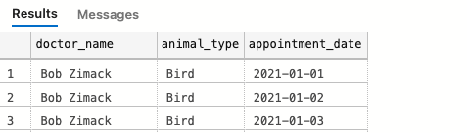
Views
4. Know doctors’ visiting history.
create view view_doctor_visiting_hisotry as
select j.doctor_firstname + ' ' + j.doctor_lastname as doctor_name,
animal_type, k.appointment_date
from doctor_animal i
join doctors j on j.doctor_id = i.doctor_id
join appointments k on k.appointment_assign_doctor = i.doctor_id
group by j.doctor_firstname, j.doctor_lastname, animal_type, k.appointment_date
go
select * from view_doctor_visiting_hisotry
go

Slide 11
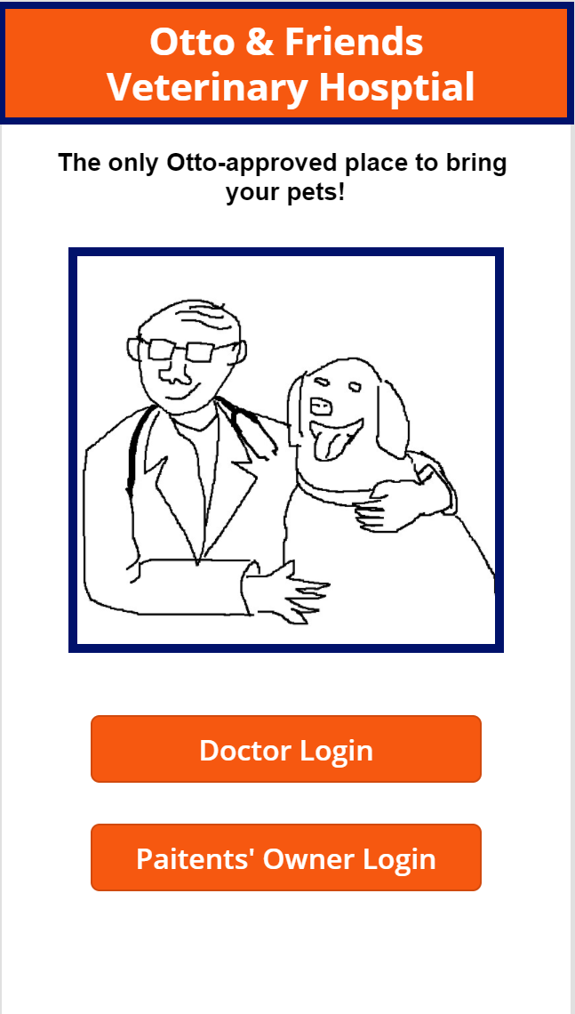
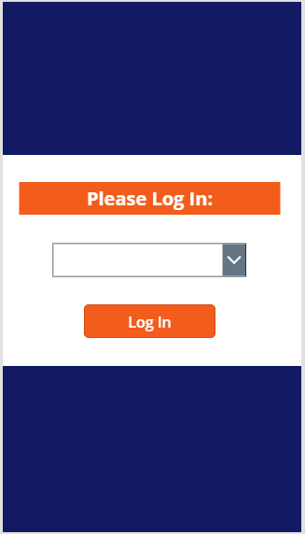
External Model Example Screens

Slide 12
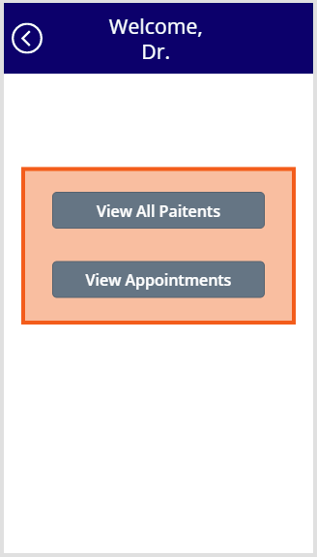
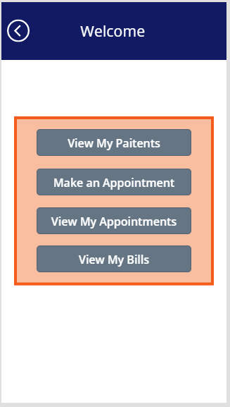
External Model Example Screens - Doctors & Owners

Slide 13
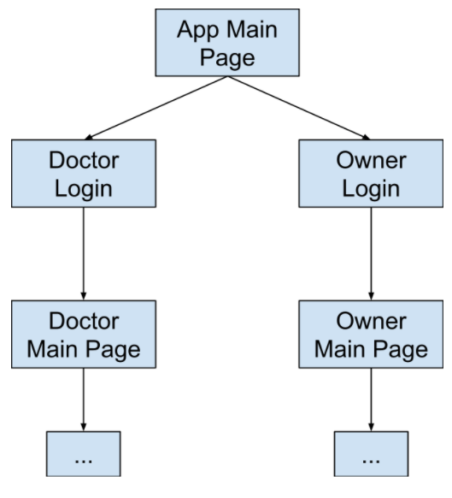
External Model Flow
Notes:
Leah

Slide 14
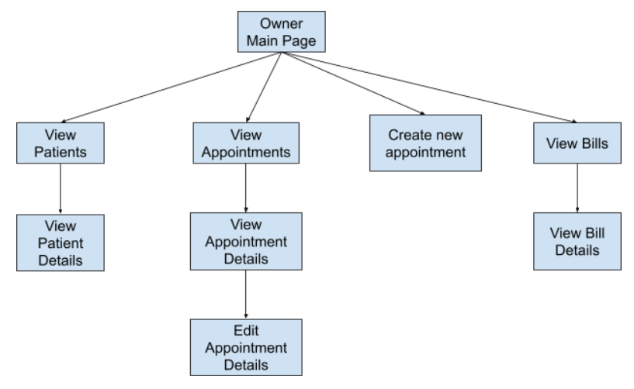
External Model Flow
Notes:
Leah

Slide 15
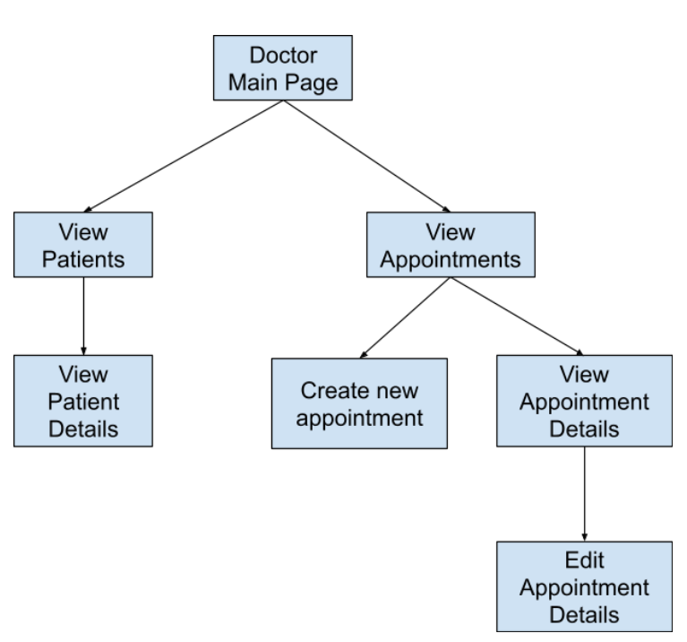
External Model Flow
Notes:
Leah

Slide 16
Team Reflection
Investigate ways to build out the database:
Add in information for Nurses or Office Administrators
Powerapps:
Passwords for login for more security
Calendar view for appointments
Notes:
everyone

Slide 17
Thank You

